Slide 1


Overview of Project and Infrastructure Financing Presenter – Rohit Tuli

Slide 2

Know your instructor
Rohit has close to 9 years of experience in planning with a wide range of organizations including international banks and semi government agencies. He has led funding feasibility and rating assignments for large Indian corporate in the renewable energy, roads and highway infrastructure and cement sectors. In a short stint, Rohit has helped in building a startup team of analysts, editors and PR agents who cover daily vagaries of equities in the US markets and write articles that are staged in CNN Money, Yahoo Finance and may other newswires websites.
Rohit Tuli
A CFA charter holder from the CFA Institute, USA
Course link: www.edureka.co/project-infrastructure-financing

Slide 3





What will you learn today?
What is Project Finance?
Parties involved
Contractual Structure
Security Structure
When things go wrong
Current Trends / Issues
Course link: www.edureka.co/project-infrastructure-financing

Slide 4
What is Project Finance?

Slide 5
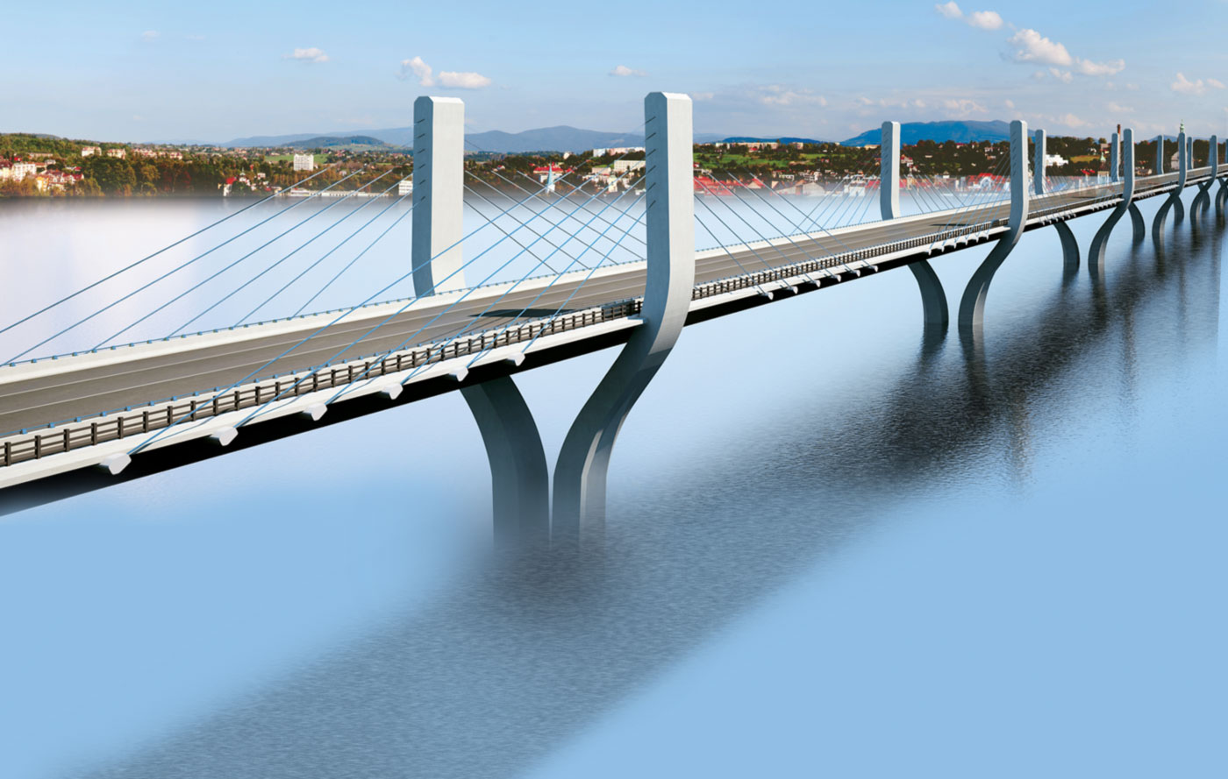
What is Project Finance?
Finance for capital intensive, long term projects such as:
infrastructure projects – building and operating hospitals, roads
power projects / oil and gas
mining projects
Contrast Corporate Finance / Acquisition Finance
Course link: www.edureka.co/project-infrastructure-financing

Slide 6


Key Features of Project Finance
Project Co is an SPV – lenders only have recourse to cash flows or revenue from the project
Lenders rely on technical and economic valuations of the project to ensure its ability to generate sufficient revenues
Capital intensive projects on greenfield site
Lengthy and complex loan documentation
Highly leveraged
Higher margins and fees to reflect risk of lenders
Course link: www.edureka.co/project-infrastructure-financing

Slide 7
Parties involved
Course link: www.edureka.co/project-infrastructure-financing

Slide 8
Parties involved (cont.)
Borrowing side
SPONSOR
Government
Private sector specialist retained by government
Private sponsor
PROJECT COMPANY
Local subsidiary
Joint Venture
Partnership of sponsors
Lending side
Commercial banks (syndicate)
Non-bank financial institutes
International agencies and ECAs
International development banks
Hedge providers
Mezzanine lenders
Course link: www.edureka.co/project-infrastructure-financing

Slide 9
Parties involved (cont.)
Suppliers
Construction stage
Operating stage
Purchasers
Purchaser’s of the project’s product(s) or service(s)
Advisers
Legal
Technical advisers
Financial advisers
Environmental advisers
Model auditors
Course link: www.edureka.co/project-infrastructure-financing

Slide 10
Contractual Structure

Slide 11
Contractual Structure
Course link: www.edureka.co/project-infrastructure-financing

Slide 12
Contractual Framework
Loan Agreement
Conditions precedent
To initial drawdown
Permits
Environmental diligence
To all drawdowns
Independent Engineer confirmation
Work proceeding in accordance with EPC contract
Sufficient funds available for timely completion
Representations and warranties
Course link: www.edureka.co/project-infrastructure-financing

Slide 13
Contractual Framework
Covenants
Financial ratios
Debt service coverage ratio
Debt to equity ratio
Dividends
Conditions
Modification of project contracts
Reporting
Events of default
Bankruptcy of sponsors or project contract counterparties
Concession or offtake agreement defaults
Ability to replace other project contracts
Abandonment
Expropriation
Course link: www.edureka.co/project-infrastructure-financing

Slide 14
Security Structure

Slide 15
Security Structure
Charge over Borrower’s assets
Real property
Equipment & inventory
License / concession
Key contracts
Bank accounts
Completion Guarantee
Direct Agreements
Course link: www.edureka.co/project-infrastructure-financing

Slide 16
Different Classes of Debt
Senior debt
Hedging liabilities
Mezzanine debt
Subordinated / junior debt
Investor debt (equity investors)
Intra-group debt
Course link: www.edureka.co/project-infrastructure-financing

Slide 17
Intercreditor Agreement
Ranking of debt and security - waterfall
Undertakings from creditors
Subordination on insolvency
Enforcement of security
Changes to parties
Amendments and waivers
Course link: www.edureka.co/project-infrastructure-financing

Slide 18
Project Finance – other financial products
Equity
Existing shareholders
New Shareholders
Mezzanine Lenders
Commercial Bank bridge and mini-perm lending
Project Bonds
Hedging
Course link: www.edureka.co/project-infrastructure-financing

Slide 19
Other Bank Roles in Project Finance
Corporate Trustee Role
Enforcing security & top of the waterfall
Indemnities
Account Bank
On Shore Operating Accounts
Off Shore Operating Accounts
DSRA
Insurance proceeds
Equity deposits
Cost overruns
Distribution Account
Course link: www.edureka.co/project-infrastructure-financing

Slide 20
When things go wrong
Waivers and amendments
Intercreditor Agreement
Standstill agreements
Sponsor debt – other debt sources
Hair cuts – priority amongst financiers
Administration
Enforcement
Course link: www.edureka.co/project-infrastructure-financing

Slide 21
Current issues / Trends
Political Risk / Modes of Protection
Insurance
Export credit guarantees
Government undertakings & Bilateral investment treaties
Market perceptions – can change over time
Land
Title, rights
Due diligence crucial
Environmental and social impacts
Change in law
Developing countries
Inconsistent policy applications / lack of clear regulatory structure
Course link: www.edureka.co/project-infrastructure-financing

Slide 22

Certifications
Get Certified in Project and Infrastructure Financing by Edureka
Go to www.edureka.co/project-infrastructure-financing
Batch starts from 31st October (Weekend Batch)
Timings: 8:00 AM to 10:00 AM
Edureka's Project and Infrastructure Financing course:
If you really want to learn how to structure the financing package for an infrastructure project or determine if an infrastructure investment is attractive for a private investor, this is definitely the course for you.
Online Live Courses: 12 hours
Assignments: 3 hours
Project: 2 hours
Lifetime Access + 24 X 7 Support

Slide 23
Thank You
Questions/Queries/Feedback
Recording and presentation will be made available to you within 24 hours

